Slide 1
AI applications in Finance
Lecture 9
Introduction to Neural Networks
29-Dec-2020
Indranil Dutta

Slide 2
Agenda – Session 9
Review of
Activation functions
Errors and Optimization methods
Use Case : Credit Card Fraud Detection continued.
Use Case : Bankruptcy Prevention.

Slide 3
Activation functions

Slide 4
Activation functions:
Activation functions determine
Output
Accuracy
Efficiency in training
Activation functions
Determine if neurons should fire or not (based on inputs it received)
Keep values between range of 0 to 1 or -1 to 1
Efficiently calculated especially if number of neurons are very large in a model.
Choice is dependent on
Which layer is the neuron on
What is the model output
How many neurons are there
How easily is the calculation
Source : https://missinglink.ai/guides/neural-network-concepts/7-types-neural-network-activation-functions-right/

Slide 5
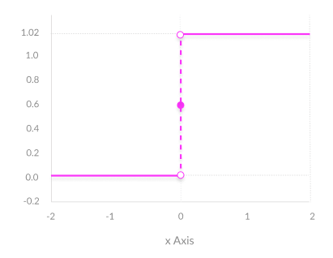
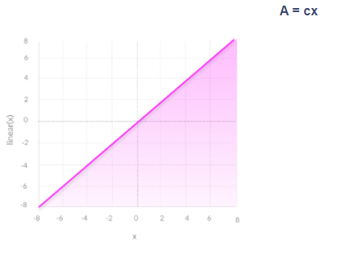
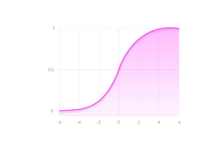
Activation functions:
Types
Binary Step (cannot handle multiple categories)
Linear
Not used in hidden layers
Output layer for regression.
Non Linear
Allow techniques like backpropagation
Allow layers to ‘stack’ on each other
Sigmoid / Logistic
Smooth
Output – range of 0 to 1
Clear predictions
Used for classifications
Issues with training
Not zero centric
Needs more calculations
Not good for hidden layers
Source : https://missinglink.ai/guides/neural-network-concepts/7-types-neural-network-activation-functions-right/, https://medium.com/@siddharth654choudhary/how-to-choose-best-activation-function-for-you-model-8af90557245b

Slide 6
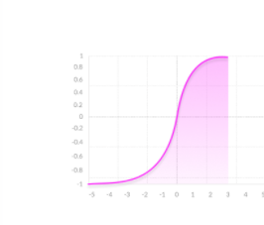
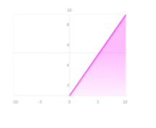
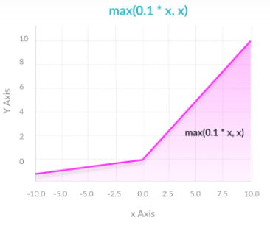
Activation functions:
Types
TanH/ Hyperbolic
Zero centric
Useful for inputs that have positive and negative values
Needs more calculations
Good for hidden layers
ReLU (Rectified Linear)
Easy on calculations
Not good for inputs that are near zero or negatives
Good for hidden layers
Leaky ReLU
Easy on calculations
Good for inputs near zero or negatives
Issues with consistency for negative values
Good for hidden layers
Softmax
Output neurons
Classifying into multiple buckets
Source : https://missinglink.ai/guides/neural-network-concepts/7-types-neural-network-activation-functions-right//, https://medium.com/@siddharth654choudhary/how-to-choose-best-activation-function-for-you-model-8af90557245b

Slide 7
Activation functions:
# | Problem | Activation Functions | Loss Functions
1 | Predicting a numerical value | Final layer – one neuron Use: Linear or ReLU | Mean Square Error
2 | Predicting Binary Outcome | Final layer – one neuron Output: 0 or 1 Use: Sigmoid | Binary Cross Entropy
3 | Predicting one class from many | Final layer – more than one Use: Softmax | Cross Entropy
4 | Predicting many objects from many classes | Final layer – more than one Use: Sigmoid | Binary Cross Entropy
Source :https://towardsdatascience.com/deep-learning-which-loss-and-activation-functions-should-i-use-ac02f1c56aa8

Slide 8
Activation functions:
Summary
For output layer
Regression
Linear
Classification
Sigmoid
Softmax (if multiple buckets)
For hidden layer
Start with ReLU (Rectified Linear)
Change to leaky ReLU
Change to others
Source : https://missinglink.ai/guides/neural-network-concepts/7-types-neural-network-activation-functions-right//, https://medium.com/@siddharth654choudhary/how-to-choose-best-activation-function-for-you-model-8af90557245b

Slide 9
Errors and Optimization methods

Slide 10
Optimization methods:
Learning Process for the network
Different techniques have different
Memory requirements
Processing speeds
Precision
Minimization of loss function (loss index)
Error
Regularization (prevent overfitting)
Source : https://www.neuraldesigner.com/blog/5_algorithms_to_train_a_neural_network, https://www.neuraldesigner.com/learning/tutorials/training-strategy

Slide 11
Errors:
Types:
Mean Squared Error (MSE)
Differences between the network output and the desired (target)
Normalized Squared Error (NSE)
Can be considered the default for regression type problems.
Similar to MSE
Weighted Square Error
Used for two category classifications where target are unbalanced
One category much greater than the other.
Gives different weights to positive and negative outcomes.
Cross Entropy Error
Used for two category classifications where target values are 0 or 1
Minkowski Error
When there are outliers
Source : https://www.neuraldesigner.com/learning/tutorials/training-strategy

Slide 12
Optimization methods:
Types
Gradient descent
Straight forward but needs many cycles or iterations.
Suitable for massive networks with a lot of parameters (in thousands)
Newton’s method
Requires less no of cycles.
Needs more processing for calculations.
Conjugate descent
In between Gradient descent and Newton’s methods w.r.t cycles.
Also suitable for massive networks
Quasi Newton method
Faster than Gradient and Conjugate gradient
Less processing w.r.t to Newton’s method
Levenberg-Marquardt algorithm
Only used with the particular type of error function (sum-of-squared)
Not for big data sets
Source : https://www.neuraldesigner.com/blog/5_algorithms_to_train_a_neural_network

Slide 13
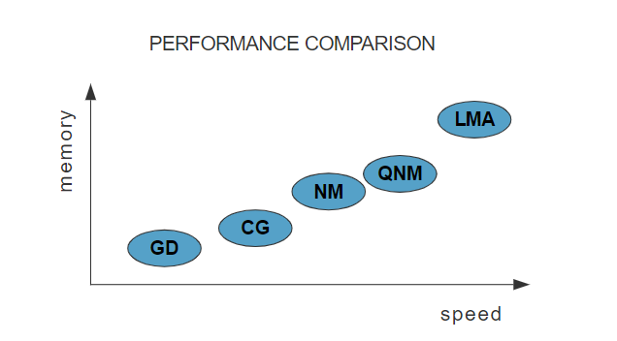
Optimization methods:
Source : https://www.neuraldesigner.com/blog/5_algorithms_to_train_a_neural_network

Slide 14
Regularization:
Minimization of loss function
Error + Regularization (prevent overfitting)
Two ways
L1
Supports feature selection – those inputs that contribute more
Generates simpler model
Not good for learning complex patterns
Deals with outliers effectively
L2
Does not support feature selection – all inputs contribute near equally.
Good for learning complex patterns
Does not deal well with outliers.
Regularization weights
Single values used in the regularization process
Default values – L1 : 0.005 , L2: 0.001
Source : https://www.neuraldesigner.com/blog/5_algorithms_to_train_a_neural_network / https://medium.com/datadriveninvestor/l1-l2-regularization-7f1b4fe948f2, https://docs.microsoft.com/en-us/archive/msdn-magazine/2015/february/test-run-l1-and-l2-regularization-for-machine-learning

Slide 15
Use Case: Credit Card Fraud Detection

Slide 16
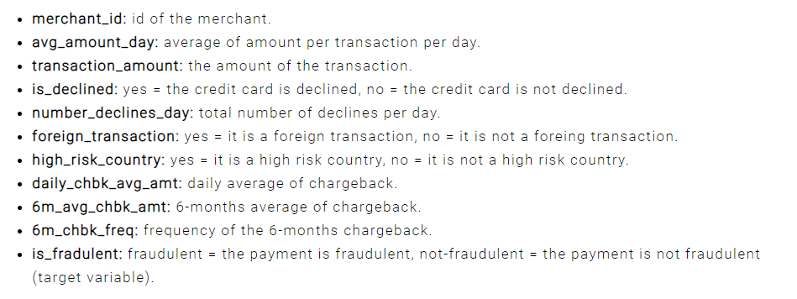
Neural Designer – Use Case – Credit Card Fraud Detection
Choose application type -> classification project
Fraudulent / Not fraudulent
Get the data set
creditcard-fraud.csv
Source : https://www.neuraldesigner.com/learning/examples/credit-card-fraud#ApplicationType

Slide 17
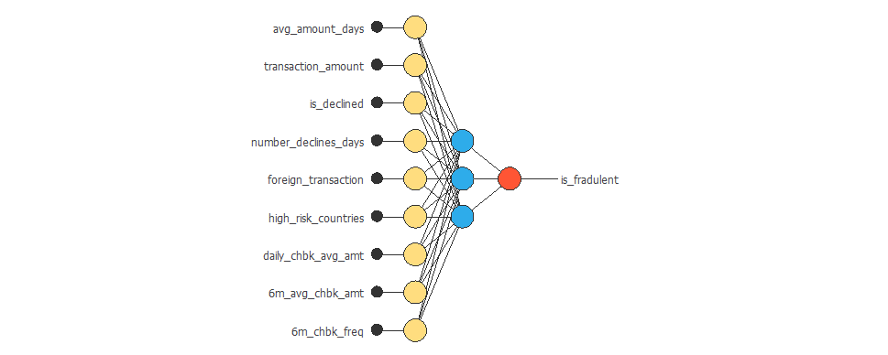
Neural Designer – Use Case – Credit Card Fraud Detection
Data instances
60% training
20% selection
20% testing
See data distribution
Balanced vs imbalanced
See the correlations
Build the network
Source : https://www.neuraldesigner.com/learning/examples/credit-card-fraud#ApplicationType

Slide 18
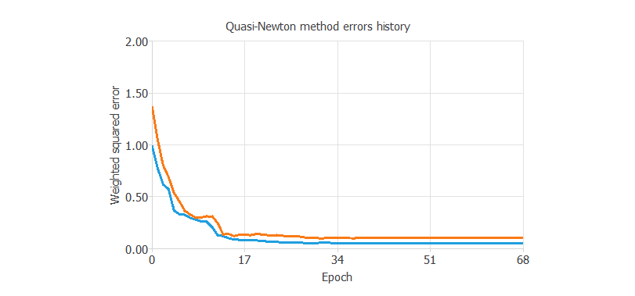
Neural Designer – Use Case – Credit Card Fraud Detection
Train the network
Loss index as default
Optimization as default
Model Selection
Order selection
Incremental model
Test the network
Source : https://www.neuraldesigner.com/learning/examples/credit-card-fraud#ApplicationType

Slide 19
Use Case: Bankruptcy Prevention

Slide 20
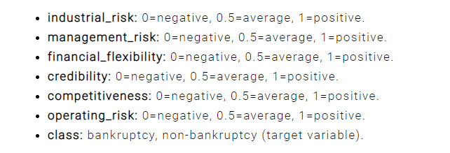
Neural Designer – Use Case – Bankruptcy Protection
Choose application type -> classification project
Bankrupt / Not Bankrupt
Get the data set
Bankruptcy-prevention.csv
Source : https://www.neuraldesigner.com/learning/examples/bankruptcy-prevention

Slide 21
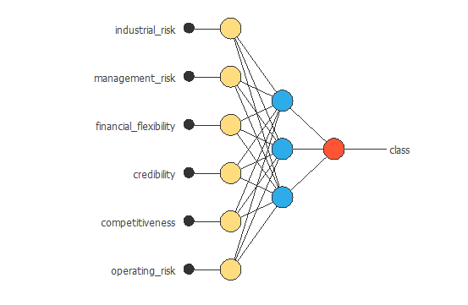
Neural Designer – Use Case – Bankruptcy Protection
Data instances
60% training
20% selection
20% testing
See data distribution
Balanced vs imbalanced
See the correlations
Build the network
Source : https://www.neuraldesigner.com/learning/examples/credit-card-fraud#ApplicationType

Slide 22
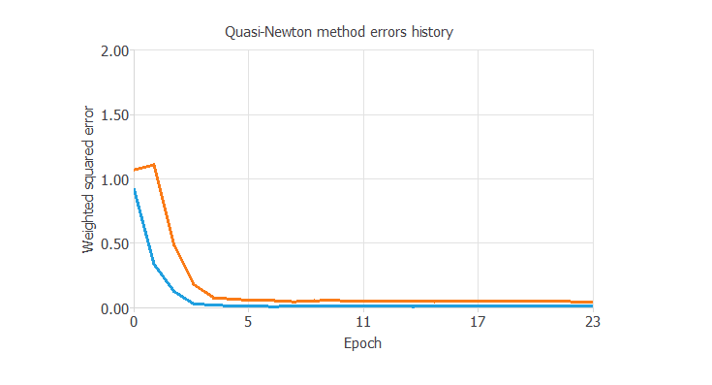
Neural Designer – Use Case – Bankruptcy Protection
Train the network
Loss index as default
Optimization as default
Model Selection
Order selection
Incremental model
Test the network
Source : https://www.neuraldesigner.com/learning/examples/credit-card-fraud#ApplicationType

Slide 23
References -------------------------------------------------------------
https://www.neuraldesigner.com/learning/examples/credit-card-fraud#ApplicationType
https://www.neuraldesigner.com/learning/examples/bankruptcy-prevention
https://missinglink.ai/guides/neural-network-concepts/7-types-neural-network-activation-functions-right/
https://medium.com/@siddharth654choudhary/how-to-choose-best-activation-function-for-you-model-8af90557245b
https://towardsdatascience.com/deep-learning-which-loss-and-activation-functions-should-i-use-ac02f1c56aa8
https://www.neuraldesigner.com/blog/5_algorithms_to_train_a_neural_network
https://www.neuraldesigner.com/learning/tutorials/training-strategy
https://medium.com/datadriveninvestor/l1-l2-regularization-7f1b4fe948f2,
https://docs.microsoft.com/en-us/archive/msdn-magazine/2015/february/test-run-l1-and-l2-regularization-for-machine-learning

Slide 24
Topics for next session
Neural Networks – Concepts and Practical examples

Slide 25
End of Session ------------------------------------------------------------------ Questions

